Slide 1
PROGRESS REPORT ABOUT DEVELOPING COUNTRIES – ASIAN RACING FEDERATION
OPEN FORUM
YU PANG FEY, CHAIRMAN, SPECIAL BODY FOR DEVELOPING RACING JURISDICTION, ARF

Slide 2
Report on The Development of Racing In Asia
By Yu Pang Fey
ARF ExCo Member
IFHA ExCo Member

Slide 3
Overview
1. New Affiliate Membership
- Turkmenistan
- Mongolia
2. Asian StudBook Conference
3. Iran
4. Korea’s first International Race

Slide 4
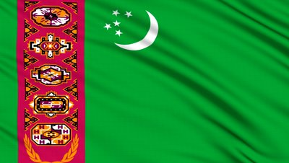
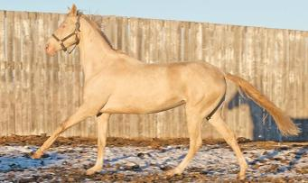
New Affiliate Membership - Turkmenistan
Turkmenistan conferred ARF Affiliate Membership in December 2012
Origin of the Akhal-Teke horse

Slide 5
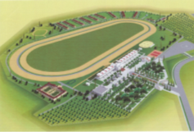
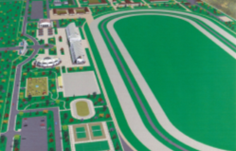
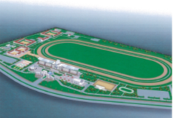
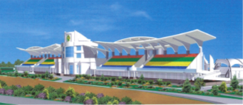
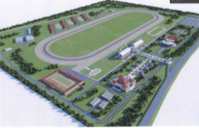
5 Equestrian complexes built in past 2 years.

Slide 6
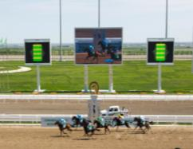
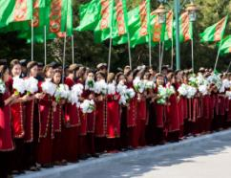
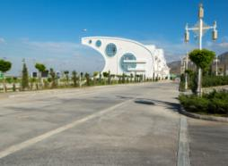
Aspire to achieve standards of flat racing found in many IFHA countries.
IFHA Affiliate Membership to be considered.

Slide 7
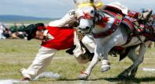
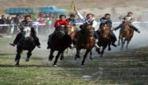
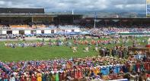
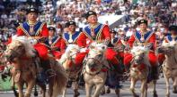
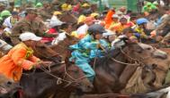
New Affiliate Member - Mongolia
Time-honoured nation of horsemen.
Two world records in August 2013
- world’s biggest parade of horses
- most number of runners in a single race

Slide 8
New Affiliate Member - Mongolia
Aspirations to develop thoroughbred racing:
construction of new racecourse.
adoption of Rules of Racing.
importation of thoroughbred breeding stock.
IFHA Affiliate Membership to be considered.

Slide 9
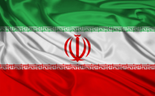
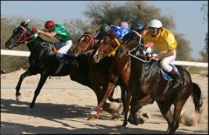
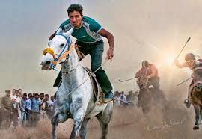
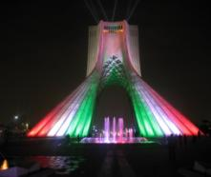
Iran
Keen interest to rebuild and grow thoroughbred racing.
ARF will explore potential of Iran to become an Affiliate Member.

Slide 10
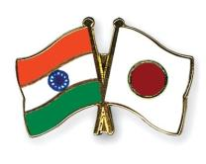
Asian Studbook Conference
Japan and India joint chairs of Asian
Studbook Conference.
India working with Kuwait to establish
Kuwait Studbook.
Japan working with Mongolia to establish Mongolian Studbook.

Slide 11
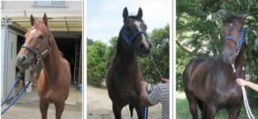
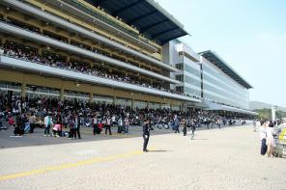
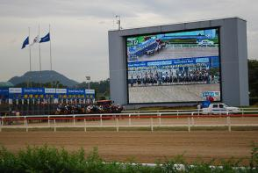
Korea’s 1st International Race
SBS ESPN Korea Japan Goodwill Cup
(1 September 2013)
Race between Korean and invited Japanese horses.

Slide 12
Highly successful.
Won by Tosen Archer from Japan.
Korean horses not far behind.
Return leg at Ohi Racecourse Tokyo on 26 November 2013.

Slide 13
THANK YOU

