Slide 1

PROGRESS REPORT ABOUT DEVELOPING COUNTRIES – EUROPEAN & MEDITERRANEAN HORSERACING FEDERATION
OPEN FORUM
BRIAN KAVANAGH, EMHF CHAIRMAN

Slide 2

THE EMHF’s WORK OVER THE PAST YEAR

Slide 3
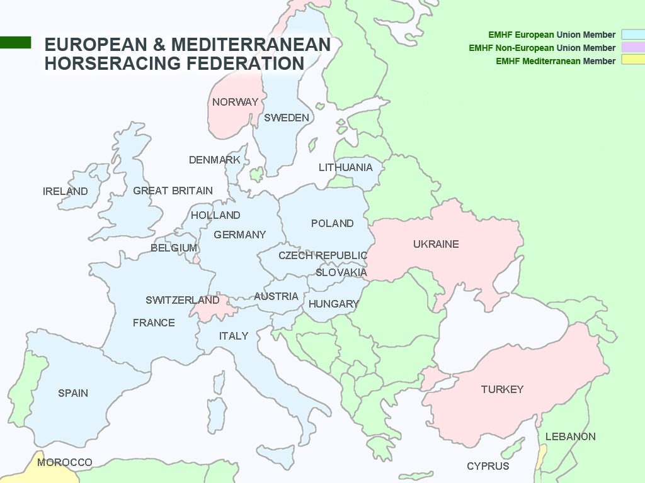

Slide 4
EMHF Statistics
23% of foals in the world
20% of the thoroughbred races in the world
27% of world betting on horse racing
Eleven of the top 15 flat races in the world in 2012

Slide 5
EMHF Programme of Practical Seminars
Handicapping Germany, August 2011
Raceday Regulation Britain, April 2012
Doping Control France, May 2013
Medical Matters Ireland, January 2014
Practical Administration (Racing & Breeding) Britain, 2014
Harmonisation of Rules Germany, 2014

Slide 6
ANTI-DOPING POLICY SEMINAR - Paris May 2013:
Austria, Belgium, Hungary, Lithuania, Morocco, Norway, Poland, Sweden, Switzerland, Turkey
20 attendees: stewards, racing chemists, vets, administrators, Lawyers

Slide 7
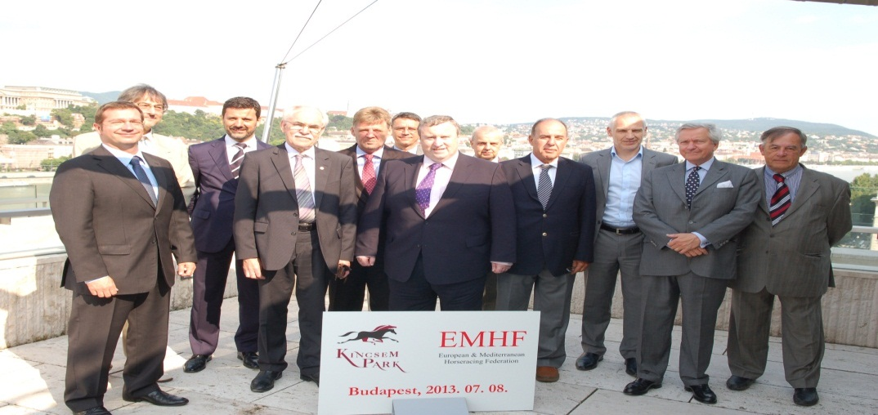
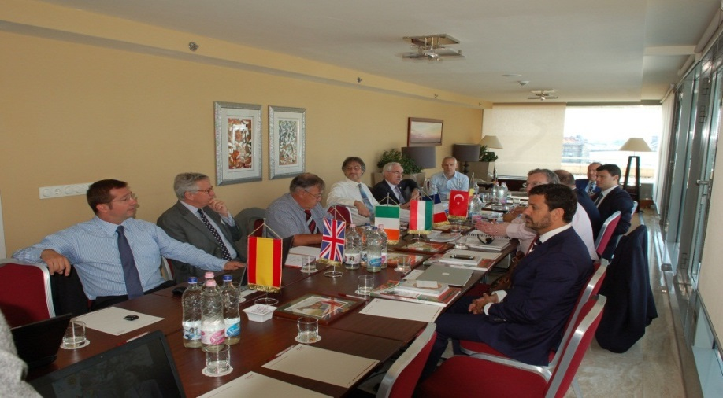
Executive Council – Budapest – July 2013
European Position on Anabolic Steroids Agreed
New Executive Council Elected

Slide 8
Executive Council July 2013 - 2016
Mr Brian Kavanagh, Ireland (Chairman)
Mr Thierry Lohest, Belgium (Vice-Chairman)
Mr Behcet Homurlu, Turkey (Vice-Chairman)
Mr Omar Skalli, Morocco (Vice-Chairman)
Mr Paul Bittar, Great Britain
Mr Manuel Garcia Orozco, Spain
Mr Zsolt Hegedus, Hungary
Mr Hubert Monzat, France
Mr Rudiger Schmanns, Germany

Slide 9
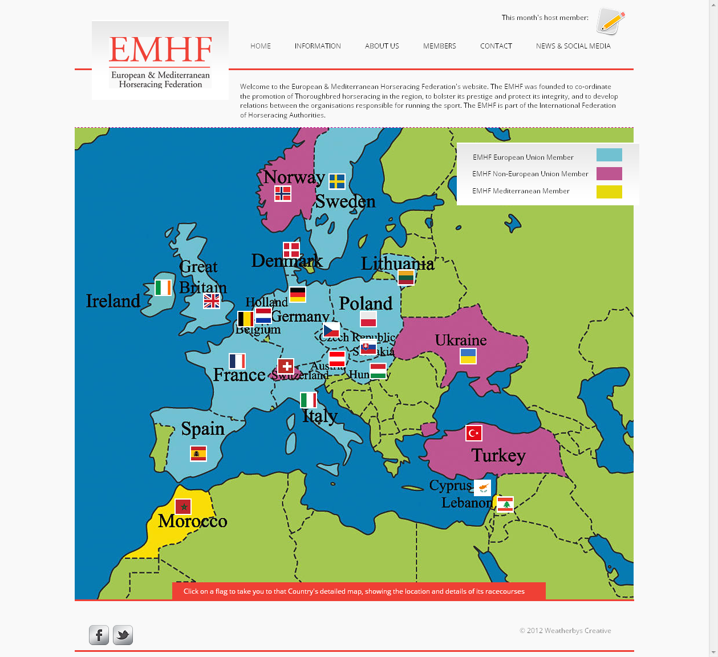

Slide 10


Slide 11
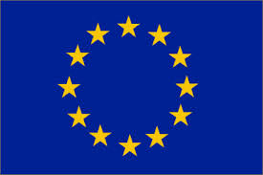
Austria
Belgium
Cyprus
Czech Republic
Denmark
France
Germany
Great Britain
Holland
Ireland
Italy
Lithuania
Poland
Slovakia
Spain
Sweden
EU Members of EMHF

Slide 13
Thank you

