Slide 1

MARKETING AND BRANDING OF RACING
RACING AND MEDIA IN THE 21ST CENTURY
MIKE MULVIHILL,
SENIOR VICE PRESIDENT OF PROGRAMMING & RESEARCH, FOX SPORTS TV

Slide 2




Slide 3




Slide 4
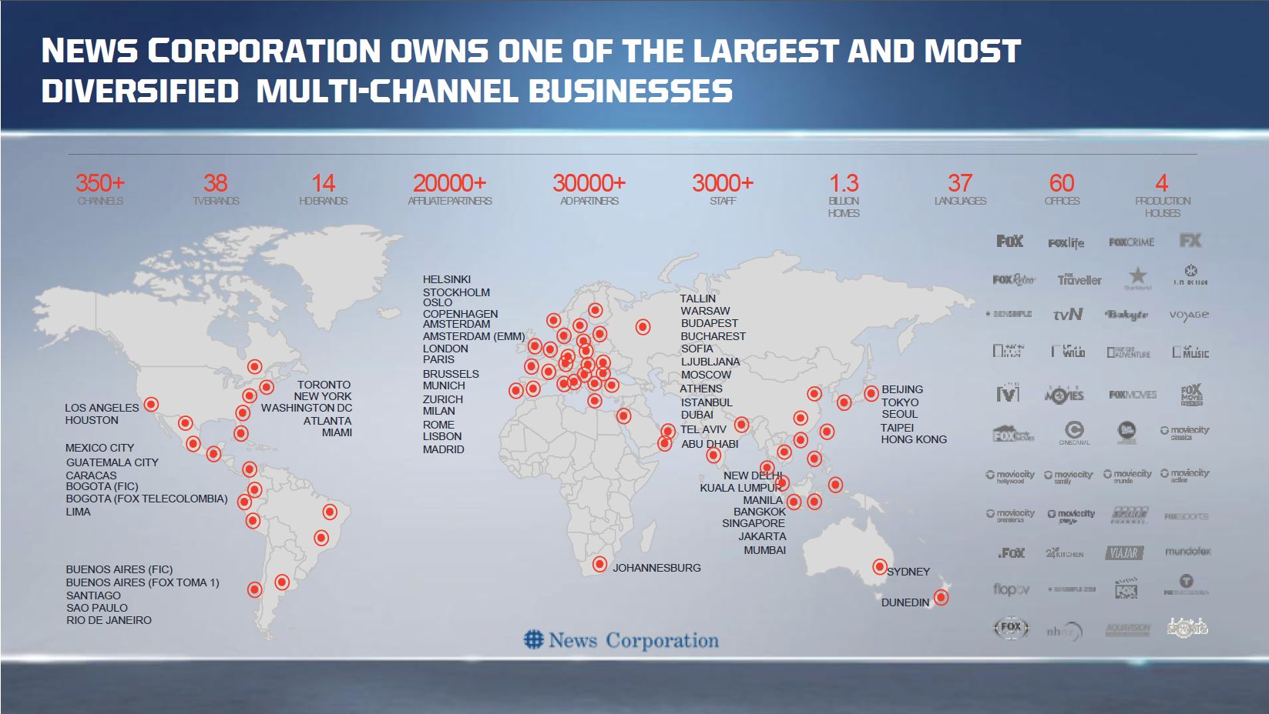

Slide 5
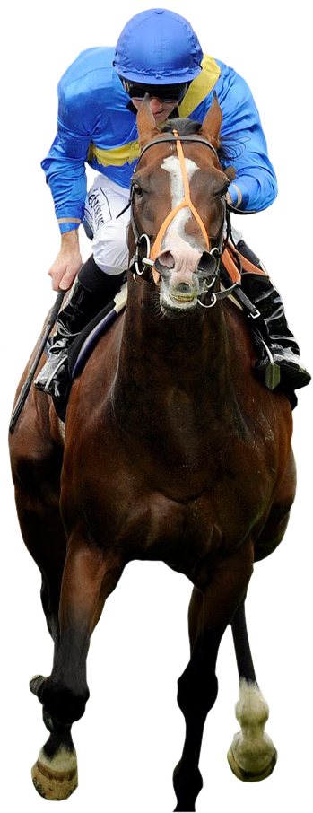
U.S. Media Landscape
7.5 Hours of TV For Every 1 Hour Online
How Video Content Is Seen
97% via Television
2% via Computer
<1% via Tablet or Mobile
3rd Heaviest TV Viewing Country

Slide 6
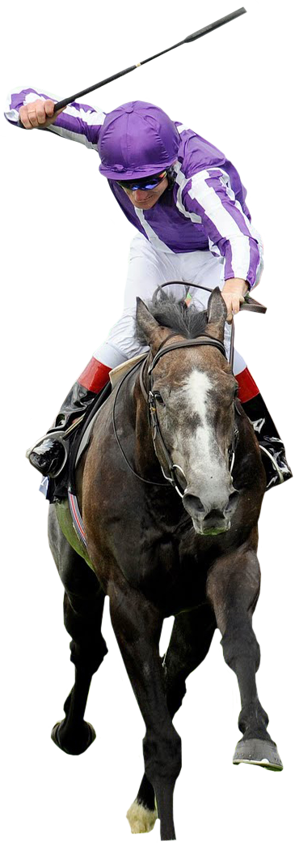
Power Of Live Sports
More Channels, More DVRs
Sports: Broad Audience Watching Live
Attracting Hard-To-Reach Consumers

Slide 7
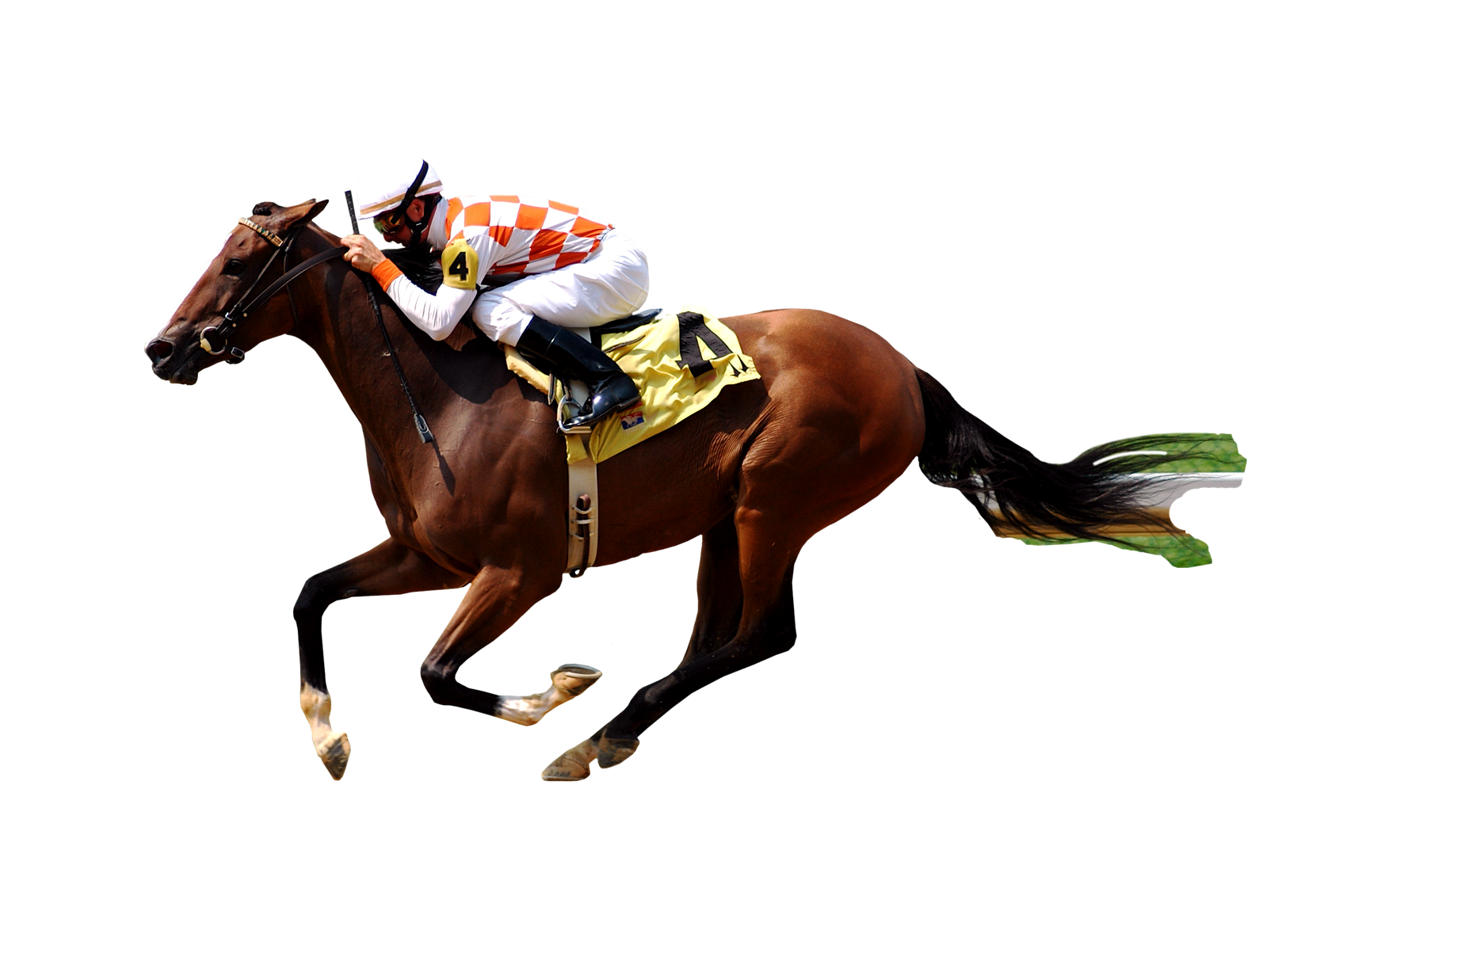
Rights Rising, New Channels Launching
Premiership, Wimbledon, USGA
FOX Sports 1, FOX Sports 2
FOX Sports Brazil, FOX Sports Holland

Slide 8

The Challenge of Younger Viewers
Average Horse Racing Viewer is 60
Attracting Younger Viewers
Hire Young, Fresh Talent
Create a Unique Visual Difference
Promote Aggressively in Young-Appeal Programs
FOX and FOX Sports Are Younger Than the Competition

Slide 9
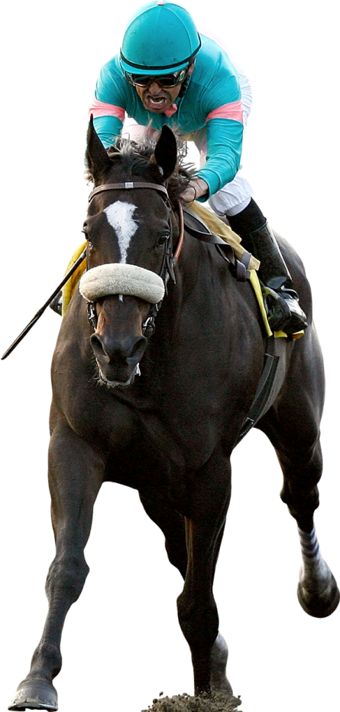
Opportunities For Horse Racing
#1 AFFLUENCE
Horse Racing Is A Premium Property Attracting
Hard-To-Reach Affluent Consumers

Slide 10
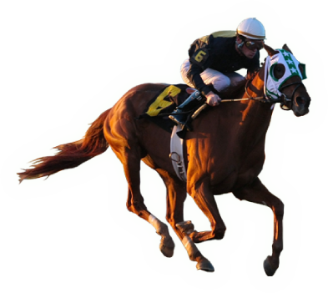
Opportunities For Horse Racing
#2 LIVE PROGRAMMING
In An On-Demand Entertainment World
Live Sports Events Command Attention

Slide 11

Opportunities For Horse Racing
#3 VOLUME OF RACES
Hundreds of Graded Stakes are Not Widely Available in the U.S.

Slide 12
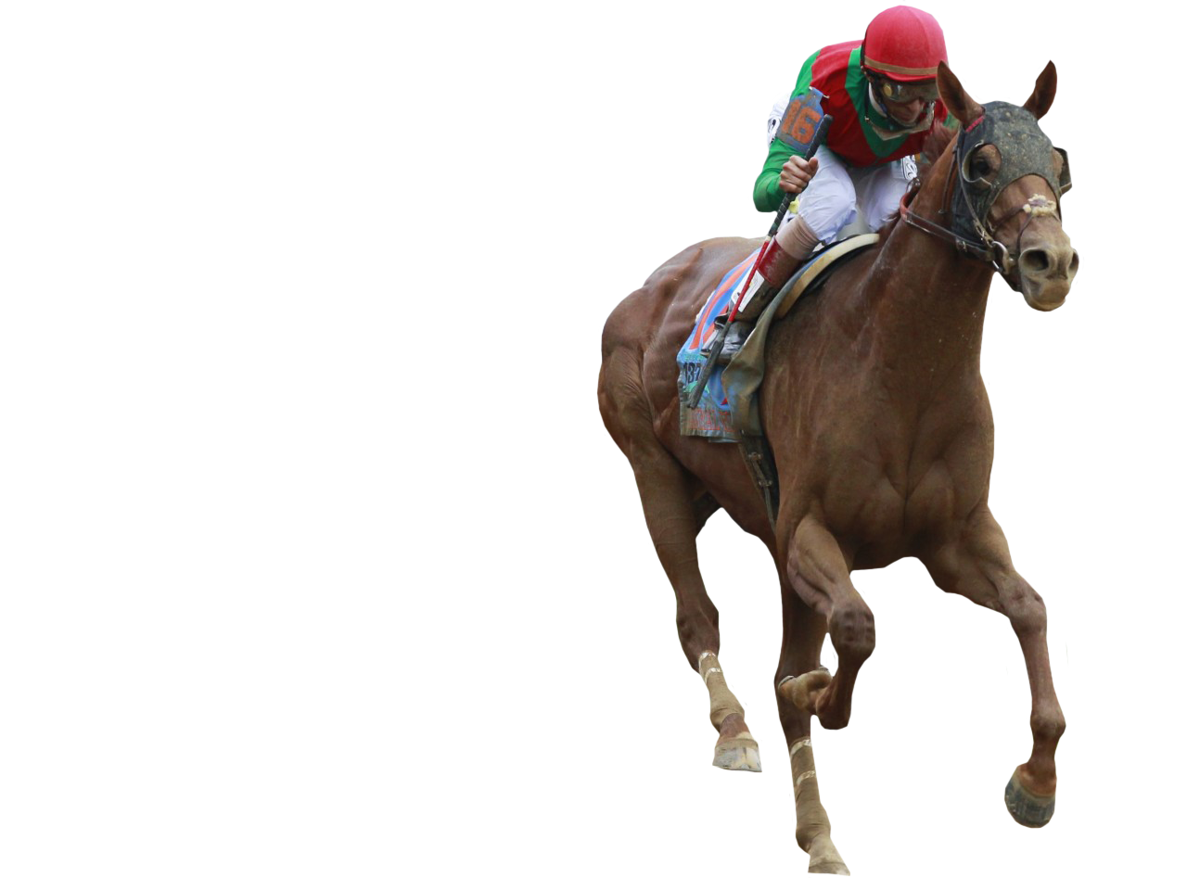
Opportunities For Horse Racing
#4 international calendar
Showcase the Glamour and Spectacle
Racing to High-Income Consumers

