Slide 1
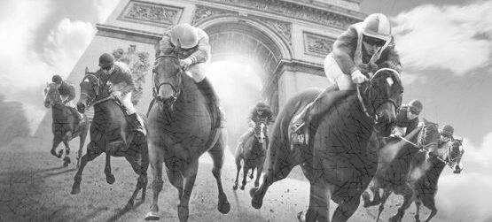
China Equine Cultural Festival Race Day, Hohhot, China
LOUIS ROMANET, IFHA CHAIRMAN
Notes:
1

Slide 2
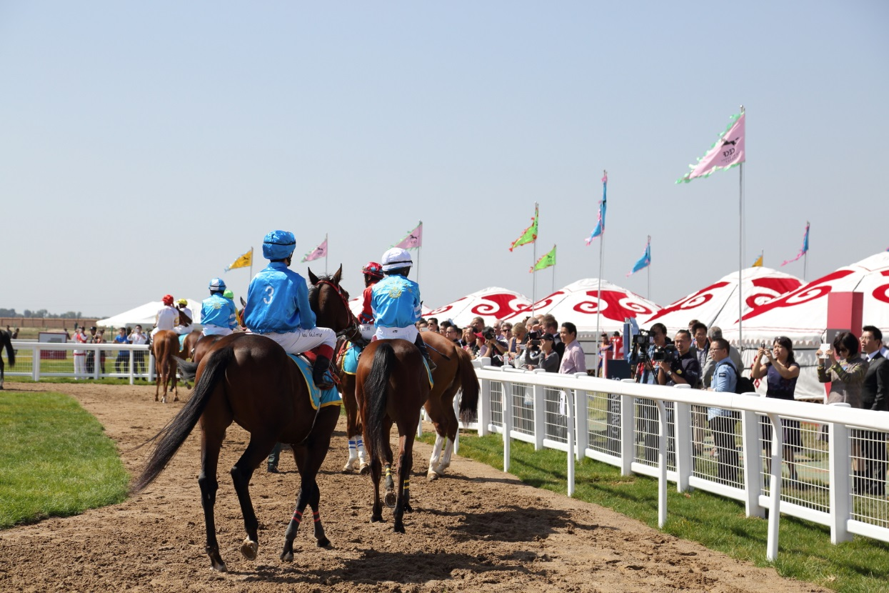
China Equine Cultural
Festival Race Day, Hohhot, China

Slide 3
